Slide 1
Coordinated Access System (CAS) Housing Referral Process
September 2024

Slide 2
Coordinated Access System (CAS) Housing Referral Process
Notes:
FACILITATOR – 1MIN
State purpose of training, workshop, webinar, etc.
Walkthrough rough agenda
Remind about any call to actions during and after
SAMPLE FOR ONLINE ONLY/HYBRID
Today's learning experience is crafted to deepen your understanding and provide actionable insights into Fair Housing and Discrimination so that you leave feeling knowledgeable and resourced with actionable next steps for your clients!
At the conclusion, we hope you can complete an exit survey. Your feedback is crucial for us to enhance future learning experiences.
Based on the poll, it looks like we have representatives from…
It also looks like we have a good variety of starting knowledge in the room…
Today we’ll begin with a quick background on the relationship between discrimination and homelessness and how the community is working to address these challenges.
We will welcome our partners from Project Sentinel and Legal Services of Northern California who will be presenting more information about the protected categories or characteristics, Equal Access and Gender Identity Rules, enforcement methods, and relevant fair housing cases and resources.
Finally we’ll end with a Q&A and reminders.

Slide 3
Session Roadmap
Introduction to Coordinated Access System (CAS) – Housing.
CAS Housing Project Types: understanding the differences and their eligibility requirements.
Understanding how clients can access potential housing opportunities.

Slide 4
You will learn…
Introduction to Survivor Coordinated Access System
Understanding the documents “Doc readiness” and what is required for CAS housing referrals
The CAS Referral Process

Slide 5
Who is Sacramento Steps Forward?
An equitable community where everyone has a safe place to call home.
Vision
Mission
To end homelessness through leadership, convening partners, data-driven best practices, and improving system performance.
Notes:
If you are new to SSF welcome!
SSF’s vision is to have an equitable community where everyone has a safe place to call home.
Our current core services fall under the categories of leadership, system planning, coordinated entry, and fund and data management.
While this training is specifically for our HUD CoC providers, the trainings we produce are broadly intended to strengthen our community’s capacity to address systemwide challenges in homeless response by partnering with and convening key stakeholders, coordinating service delivery, and administering funding and HMIS.

Slide 6
Coordinated Access System (CAS)
Notes:
Talk about how this only the standard system and we will cover the survivor system later in the presentation

Slide 7
What is Coordinated Access?
“A streamlined system designed to match people experiencing homelessness with housing and service options.
This process prioritizes limited local supportive housing resources, so people with the highest vulnerability can be connected to support as quickly as possible.”

Slide 8
CAS Goals
To increase the efficiency of the local crisis response system.
Improve fairness in how housing and services are allocated.
Facilitate rapid access to housing and services

Slide 9
Coordinated Access is NOT …
First come, first served: Referrals or services are provided in the order that clients apply or seek assistance.
Back-door or side-door referral processes: Direct referrals made through personal connections rather than following the standard Coordinated Access System procedures.
Closed referral system: Referrals limited to specific programs or agencies, often with restricted access criteria.
Opaque processes: Unclear or undefined procedures for obtaining referrals or accessing resources.

Slide 10
Essential
Elements of the Housing Referral Process
Access
Assessment
Prioritization
Verify required documents
Confirm Client Interest
Referral Submission
CAS Housing Program Enrollment
Referral Preparation
Referral Process Start
Notes:
Provide additional details on 211 Add the Shelter Survey Training.

Slide 11
Access in Sacramento
211 Access: Contacting 211 and pressing 8 connects individuals with 211 staff who can discuss emergency shelter, housing problem-solving, and housing resources.
Street Outreach: Direct service providers within the Continuum of Care (CoC) offer outreach services to individuals in need.
CAN Navigators: Navigators who assist individuals with accessing services and navigating the housing system.
CAS Assessors: Assessors who evaluate individuals' needs and connect them with appropriate housing resources and services within the CAS framework.
Notes:
Provide additional details on 211 Add the Shelter Survey Training.

Slide 12
Assessments
Vulnerability Index - Service Prioritization Decision Assistance Tool (VISPDAT)
Individuals who are literally experiencing homelessness
Options available for both singles and families.
All prioritized clients are selected based on the results of this assessment.
Landlord Engaement Assistance Program Assessment
Housing navigation and landlord incentive program for clients with active SHRA vouchers or Rapid Rehousing (RRH).
Foster Youth Initiative Assessment
Designed for Transitional Age Youth who were in foster care after the age of 16 and require a housing subsidy.
Notes:
Once a client connects with a CAS Assessor, a housing conversation should be initiated during which clients complete HMIS housing assessments.
Provide additional details on 211 Add the Shelter Survey Training.
Provide additional details on 211 Add the Shelter Survey Training.

Slide 13
Prioritization
During the assessment, individual needs and levels of vulnerability are evaluated to determine prioritization.​
This prioritization aids the CoC in managing its inventory of community housing resources and services, ensuring that individuals with the most critical needs and vulnerabilities receive the necessary support to resolve their housing crises.
Priority List Schema
VI-SPDAT within 15 months
Logged services within 90 days
65+ years old
Chronic Health Conditions
Length of time homeless

Slide 14
Survivor-Coordinated Access System (S-CAS)
For HUD’s Definition of Category 4 Homelessness: Fleeing or Attempting to Flee Domestic Violence*
Notes:
*HUD and CoC will often refer to this shortened, simpler version of the Definition of Category 4 Homelessness, however when we are referring to “Domestic Violence” it includes dating violence, human trafficking, sexual assault, stalking, and other dangerous or life threating conditions that relate to violence against the individual or family member that either takes place in, or has them afraid to return to their primary night times residence.

Slide 15
A Confidential System for Survivors
In 2020, the Department of Housing and Urban Development (HUD) awarded 2 Rapid Rehousing (RRH) programs in Sacramento funding to house survivors fleeing or attempting to flee domestic violence, sexual assault, human trafficking, and other life-threatening conditions
Since then, we have added an additional 2 RRH programs, as well as a Permanent Supportive Housing (PSH) Program
As part of the award, HUD requires CoC’s to provide safe and confidential access through the Survivor Coordinated Access System (S-CAS)
S-CAS is aimed to be inclusive of Victim Service Providers (VSPs) and those with training and knowledge for how to best support survivors in our community
Notes:
HUD and VAWA prohibits VSPs from entering personally identifiable information (PII) into HMIS, therefore we developed an inclusive system for VSPs to still access services for survivors, without the risk of breaking confidentiality and the safety of survivors. S-CAS’s goal is to increase resources for survivors and promote access to safety and crisis needs by those with the trainings and skills to best assist them.

Slide 16
Survivor Coordinated Access System (S-CAS) Programs
Programs | Amount of Units | Program Description
Opening Doors Inc. | 20 RRH Units | RRH is housing that provides short-term (up to 3mos) and medium-term (4-24mos) tenant-based rental assistance and supportive services to survivors. Aimed to assist clients in achieving self-sufficiency and be able to afford rent on their own at the end of services.
My Sister’s House | 10 RRH Units
Shelter Inc. | 11 RRH Units
Lao Family Community Development | 13 RRH Units
WEAVE Inc. | 9 PSH Family Units (2-5 person) | Tenant-based voucher rental assistance and supportive services for families of 2-5 persons provided with no maximum term and ongoing case management to survivors
Notes:
New partner joining soon Bridging Initiatives international with a TH & RRH bringing in 6 new units

Slide 17
Essential
Elements of
Survivor Coordinated Access
System (S-CAS)
1. Confidentiality
2. Access
3. Assessment
4. Problem-Solving
5. Prioritization
6. Referral
Notes:
This biggest difference between CAS and S-CAS is this first element, Confidentiality. The system was built to protect survivors confidentiality and ensure safety, along with ensuring survivors are obtaining services from those with the knowledge and training to manage survivors safety and confidentiality needs. For instance, VSP staff complete 40-56 hours of training to get certified to serve survivors. Since they are prohibited from entering Personally identifiable information into HMIS, through the Survivor System, they are able to get their participants document ready and access to services in a manner that maintains the survivors confidentiality.
Currently survivors can only access S-CAS through one of our victim service providers connected to S-CAS. Survivors can also access standard system resources through HMIS using anonymous profiles to protect confidentiality.
When survivors are connected to VSPs, they are able to assess the survivor for any crisis and safety concerns, as well as other for other resources they may need, such as housing, health care, employment, education, etc.
Just like everyone else, there is a lack of resources available for survivors in our community. However, our VSPs do their best to support survivors various needs, including access to safe houses and shelters, safety planning, and providing access to resources while they navigate for more permanent housing solutions.
To access S-CAS, survivor specific prioritization questions are asked in order to prioritize those most vulnerable for housing opportunities. Through the survivor system, VSPs are able to get their participant doc ready and prioritized for openings without risking breach on confidentiality.
Once housing opportunities arise, those highest on the priority list are then referred to that opening.

Slide 18
S-CAS Eligibility Requirements
S-CAS Programs | Rapid Rehousing (RRH) | Permanent Supportive Housing (PSH)
Eligibility Requirements | Meets Category 4 Homelessness:​ ​ Is fleeing, or is attempting to flee domestic violence; AND​ Has no other residence; AND​ Lacks the resources or support networks to obtain other permanent housing | Meets Category 4 Homelessness​ Chronically Homeless Certified Disability​ Income below 30% ​ US Identification Documents (ID)​ Social Security Card
Notes:
*Important note: If they meet this definition AND they have are already in a HUD subsidized housing program (such as RRH, PSH, voucher, etc.), they qualify for a VAWA emergency transfer. VAWA emergency transfers are prioritized over all participants within the CoC. We will be training soon on VAWA and requesting transfers, but you can visit HUD’s VAWA webpage in the meantime to see what qualifies for VAWA and reach out to us if you have any questions.

Slide 19
Accessing S-CAS
Provider identifies survivor in need of survivor-specific resources
Provider refers survivor to VSP Access Point
VSP Access Point establishes eligibility & administers prioritization questions
VSP Access Point adds client to S- CAS list to be prioritized for housing
As open units become available, survivors are referred from S-CAS priority list.
Notes:
Who is a VSP?
Per HUDs definition, a VSP is a nonprofit organization whose primary mission is to provide direct services to survivors included in the category 4 of homelessness. Eligible services include shelter and non-residential programs, rapid rehousing, transitional and permanent housing providers, and supportive services such as therapy, case management, outreach, etc. Due to confidentiality protections, the SCAS is exclusive to local VSPs. To join SCAS the VSP must complete an SSF onboarding training which will grant the provider access to case conference and ability to add clients to the priority list for housing opportunities. For non VSPs, we encourage them to connect their clients to a participating VSP for survivor specific services and access to SCAS. VSPs have extensive survivor advocate training to best support this community.

Slide 20
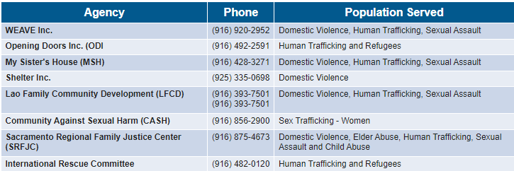
Current VSP Access Points for S-CAS
Notes:
WEAVE is currently the only access point that takes calls from 211

Slide 21
Recent New VSP S-CAS Access Point Additions
Agency | Phone | Population Served
Bridging Initiatives International | (916) 970-5164 | Domestic Violence
Inter-Tribal Council of CA | (916) 973-9581 | Domestic Violence, Sexual Assault
3Strands Global Foundations | (916) 365-2606 | Human Trafficking
Connect2Change | (916) 287- 3312 | Sex Trafficking - Women
Full list of S-CAS VSP Access Points
Notes:
Will also provide a comprehensive list of the participating VSP partners along with the presentation materials.

Slide 22
S-CAS System Goals
Continue to update confidentiality and safety policies and procedures for survivors accessing services in CoC.
Create pathways and processes for survivors accessing services with non-VSPs.
Continue coordinating and triaging with central call line (211) and VSPs
Increase accessibility and options to safe housing for survivors.
Establish a comparable and confidential database for victim service providers.
Notes:
Ensure Safe and Confidential Access
Have clear written protocols
Survivor driven choice
Enhance trauma informed access and process for survivors
Broaden Assessment Tools and Process
Incorporate risks and danger assessments early on
Offer connections to VSPs early on
Reference Practical Considerations
Build relationships with VSPs to ensure inclusiveness
Evaluate the CE system
Evaluate current referral and processes
Develop language access to LEPs
LEP = Limited English Proficiency

Slide 23
BREAK TIME
Notes:
Please remind guests to return at XX time.

Slide 24
Verification of Required Referral Documentation "The Basics"
Notes:
"The Basics" refer to the minimum documents required for a referral to be completed in HMIS.
Additional documents may be necessary from the housing program, such as pay stubs, bank account statements, and proof of identity.

Slide 25
"The BASICS"
Permanent Supportive Housing (PSH) Document Readiness
Chronicity Certification- never expires
Disability Certification- never expires
Homeless certification- valid for 90 days
Valid ID
Social Security Card
*Birth certificates of minors in the household
Notes:
Emphasizing the difference and use of PSH and PH- really knowing these acronyms is helpful.

Slide 26
"The BASICS"
Permanent Housing (PH) Document Readiness
Homeless certification- valid for 90 days
Valid ID
Social Security Card
Birth certificates of minors in the household.
Notes:
Emphasizing the difference and use of PSH and PH- really knowing these acronyms is helpful.

Slide 27
Case Conferencing Tool
Purpose:
Establishes a centralized place for vital information crucial in facilitating potential housing placements.
Facilitates tracking of a client's journey across different service providers.
Assists in monitoring verified Document Ready Status (SSF use only).
Notes:
Policy:
Clients connected to a service provider must have a Case Conferencing (CC) tool created and/or updated.

Slide 28
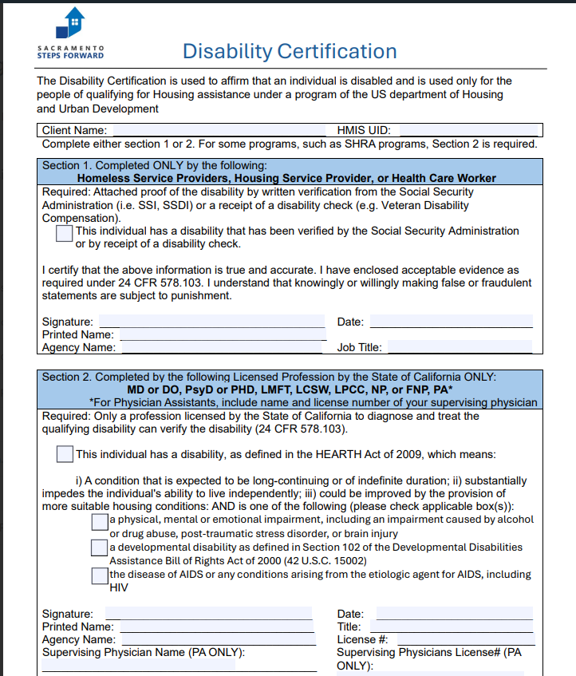
Document Readiness Forms
Disability Certification (PSH programs)
Does not expire
Must complete one or both sections
Section 1:
Can be completed by a Homeless Service Provider
Upload SSI, SSDI, or receipt of disability benefit onto HMIS
Be sure to check box
Section 2:
Can be completed ONLY by licensed professionals
Be sure to check box
Be sure that license # is written

Slide 29
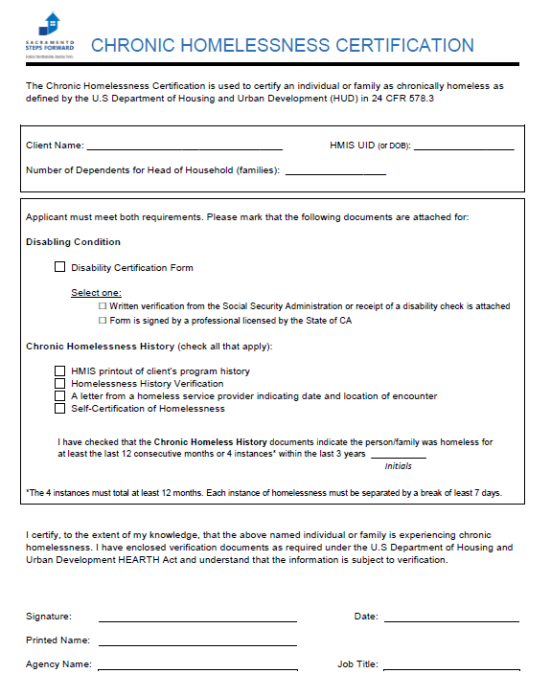
Document Readiness Form
Chronic Homeless Certification
(PSH programs)
Does not expire
Fill out completely
Chronic homelessness history can be verified in the following ways:
HMIS program verification
Third Party Homelessness History Form
Agency/Third party letter
Client self-certification (up to 3 months)
Indicate types of verification used for chronicity and disability

Slide 30
Document Readiness Forms
Verifying chronic homelessness status (12 months):
Up to three years of homeless history
Have experienced homelessness (Category 1 or 4) continuously for at least the last 12 months
OR at least 4 occasions in the last 3 years, where the combined occasions total at least 12 months.
Occasions must be separated by a break of at least seven nights
Stays in institution of fewer than 90 days count towards homelessness and do not constitute a break OR
An individual who has been residing in an institutional care facility for fewer than 90 days and met chronic status prior to admission to institutional care facilities
A written observation by an outreach or intake worker, community member, or housing or service provider of encounters with the individual or head of household that includes a description of the conditions where the individual or head of household was living or is currently living.
The outreach worker or intake worker cannot provide third-party documentation for months in which they did not encounter the individual or head of household
One day of experiencing homelessness within a month will be counted towards the whole month
Ex. if a client is experiencing homelessness one day of the month for every month in January until April, that is 4 months of experiencing homelessness. It is also considered 4 separate episodes of homelessness.
Family members do NOT count as a third party.

Slide 31
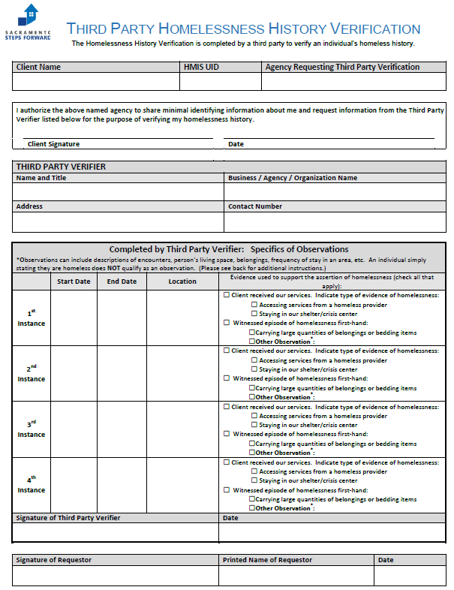
Document Readiness Forms
Third Party Verification
(PSH programs)
The client must add their signature authorizing an agency to complete this form.
The agency provides verification that they firsthand witnessed the client experiencing homelessness.
Your signature
Notes:
Emphasize that this used for the chronic verification.

Slide 32
Document Readiness Forms
Location (such as the actual address or geographic name of area)
Date Fields
Ex. 05/01/21- 08/01/21

Slide 33
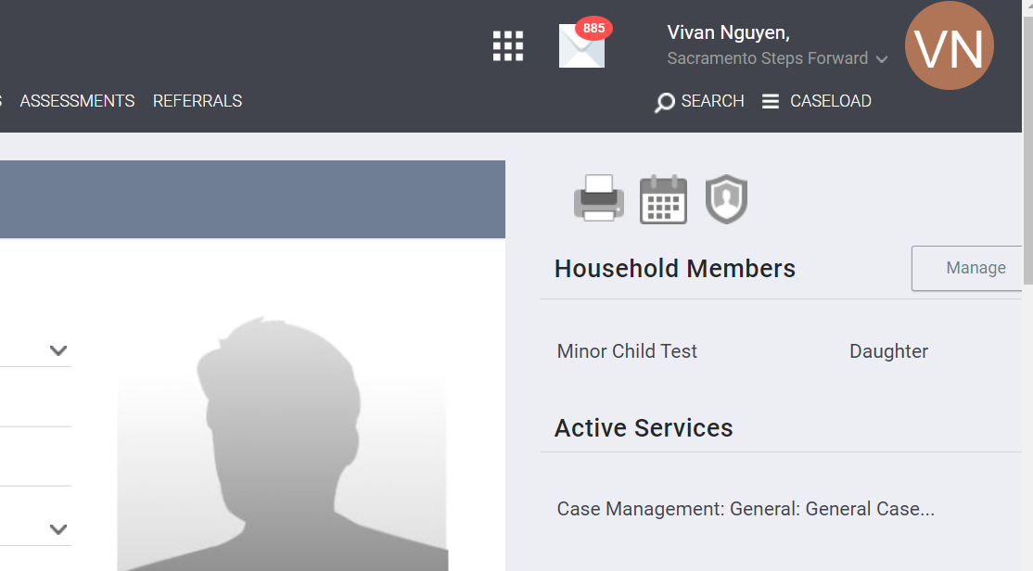
Document Readiness Forms
Third Party History Report through HMIS
Go to client’s profile
By the upper right hand side, select Printer icon to pull reports

Slide 34
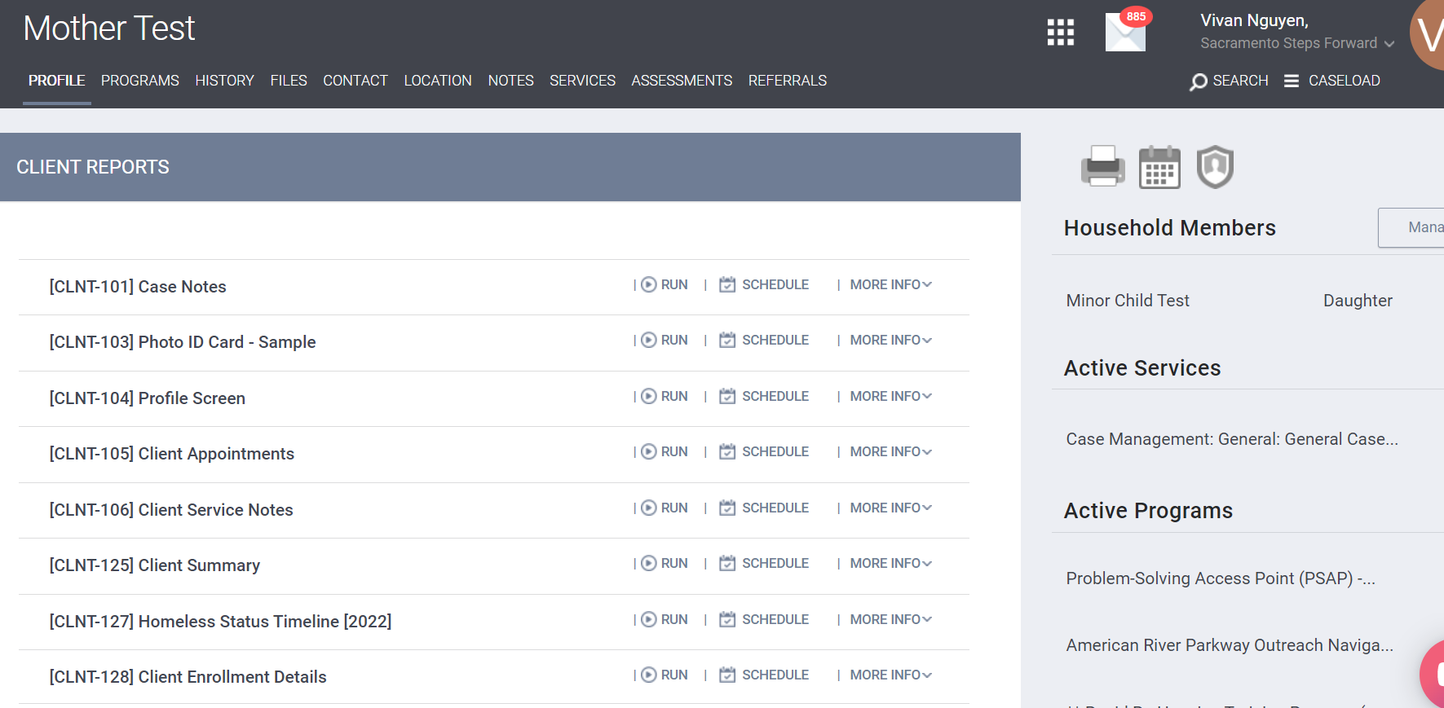
Document Readiness Forms
3. Select “Run” on the Homeless Status Timeline

Slide 35
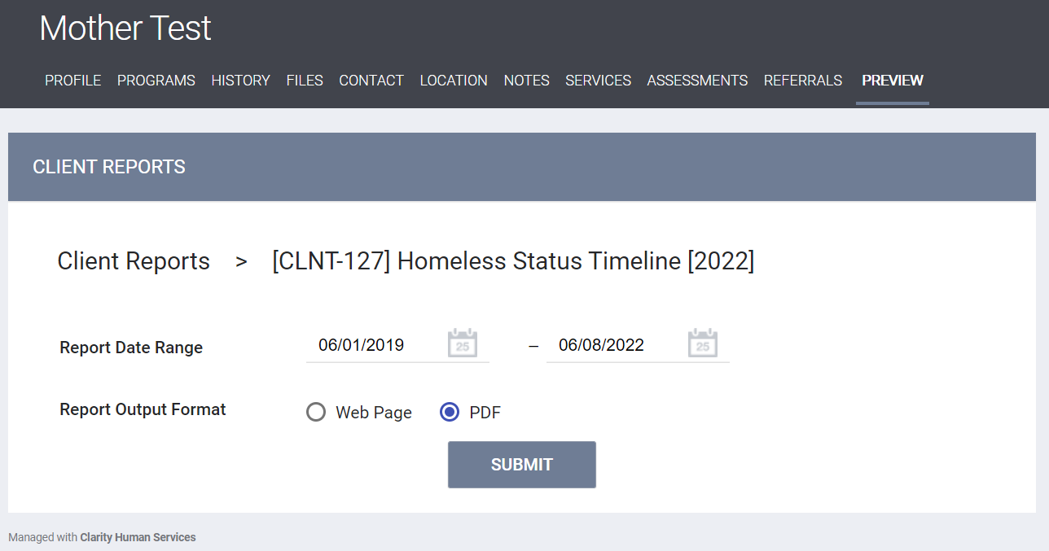
Document Readiness Forms
4. Enter report range
Start date should be 1st day of the month, 3 years prior to current month
End Date should be current date
5. Select Report Output format as “PDF”
6. Select SUBMIT
Please wait for the report to generate before exiting the page.

Slide 36
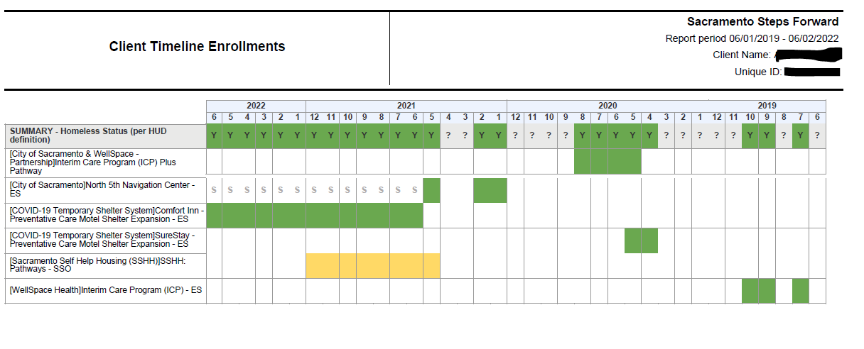
Document Readiness Forms
SUMMARY- Homeless Status: Boxes must be green with a “Y” to be counted towards homeless verification
This example has 12 continuous months of experiencing homelessness

Slide 37
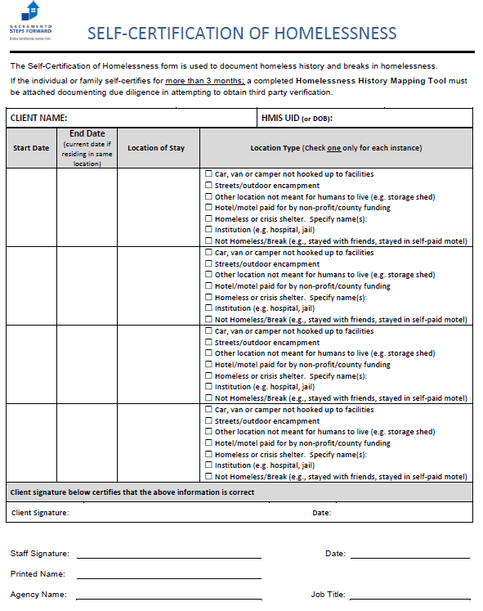
Document Readiness Forms
Self-Certification (PSH programs)
Client is able to self certify 3 months of their homeless history
Within the last 3 years
Make sure that it does not overlap with other third party verified months
Your signature

Slide 38
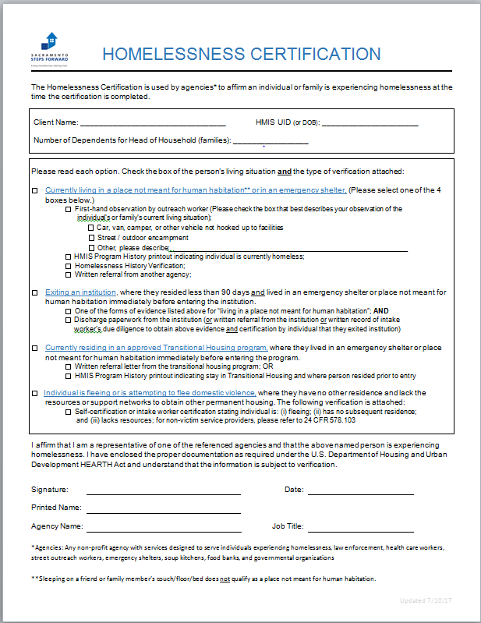
Document Readiness Forms
Homeless Certification (All programs)
Expires after 90 days
Please fill out everything!
Check box and type of verification attached
Provider/ Case Manager’s information and signature

Slide 39
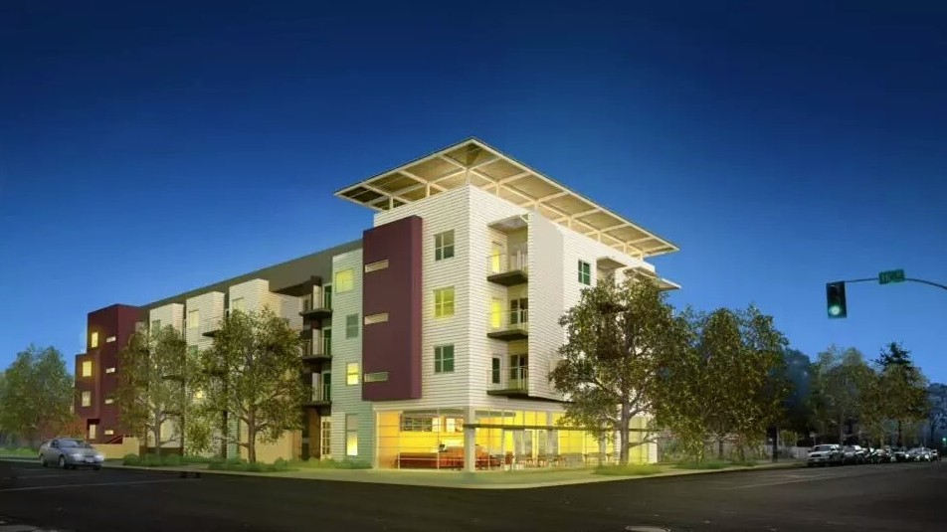
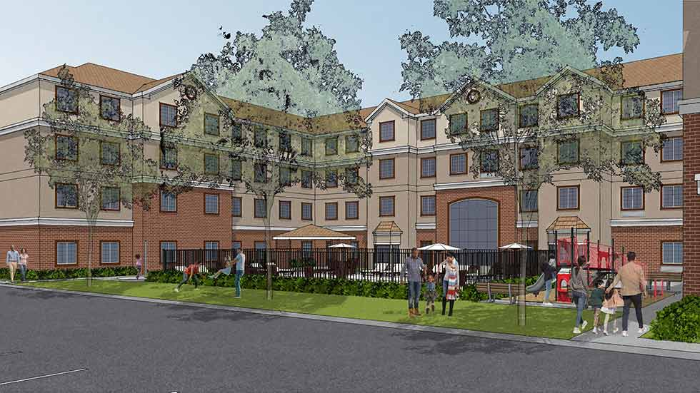
CAS Housing Program Types

Slide 40
HUD Definition
Homeless Category 1
Literally Homeless
Individual or family who lacks a fixed, regular, and adequate nighttime residence, meaning:
Has a primary nighttime residence that is a public or private place not meant for human habitation; or
Is living in a publicly or privately operated shelter designated to provide temporary living arrangements (including congregate shelters, transitional housing, and hotels and motels paid for by charitable organizations or by federal, state and local government programs); or
Is exiting an institution where (s)he has resided for 90 days or less and who resided in an emergency shelter or place not meant for human habitation immediately before entering that institution.
Notes:
Link for HUD definition

Slide 41
HUD Definition
Homeless Category 4
Fleeing/Attempting to Flee Domestic Violence (DV)
Is fleeing, or is attempting to flee, domestic violence, human trafficking, dating violence, sexual assault, stalking, or other dangerous or life-threatening conditions that relate to violence against the individual or a family member, including a child, that has either taken place within the individual’s or family’s primary nighttime residence or has made the individual or family afraid to return to their primary nighttime residence*; AND
Has no other residence; AND
Lacks the resources or support networks to obtain other permanent housing.
Notes:
*Important note: If they meet this definition AND they have are already in a HUD subsidized housing program (such as RRH, PSH, voucher, etc.), they qualify for a VAWA emergency transfer. We will be training soon on requesting transfers.
Link for HUD definition

Slide 42
HUD Definition
At Risk of Homelessness:
• Has an annual income below 30% area median income;
• Does not have sufficient resources or support networks immediately available to prevent them from moving to an emergency shelter or into homelessness;
• Is exiting a publicly funded institution, or system of care (such as a health-care facility, a mental health facility,
AND…
Notes:
Link for definition on HUD site

Slide 43
HUD Definition
At Risk of Homelessness Continued
Meets one of the following conditions:
• Have moved because of economic reasons two or more times during the 60 days immediately preceding applying for homelessness assistance;
• Is living in the home of another because of economic hardship;
• Has been notified in writing that their right to occupy their current housing or living situation will be terminated within 21 days of the date of application for assistance; (due diligence needs to be done to confirm they will lose their housing without one time financial assistance; i.e. eviction notice)
• Lives in a hotel or motel that is not paid for by charitable organizations or by federal, State, or local government programs for low-income individuals;
• Lives in a single-room occupancy or efficiency apartment unit with more than two people, or lives in a larger housing unit in which there reside more than 1.5 people per room.
Notes:
Link for definition on HUD site

Slide 44
Permanent Supportive Housing (PSH)
Permanent Supportive Housing (PSH) is permanent housing in which housing assistance (e.g., long-term leasing or rental assistance) and supportive services are provided to assist households with at least one member (Head of household) with a disability in achieving housing stability.
What is needed for a referral?
VI-SPDAT V2
Homeless Certification
Disability Certification
*Chronic Homelessness Certification
*12 months of experiencing homelessness verified
Social Security Card
Valid ID
Birth Certificate and Social Security cards
*Only needed for minor household members (under 18yo)
Eligibility Requirements
Category 1 OR 4 Homeless
Disability
Chronicity

Slide 45
Permanent Housing (PH) with Services
Permanent Housing (PH) is a community-based housing model, the purpose of which is to provide housing without a designated length of stay. PH program participants must be the tenant on a lease (or sublease) which must:
have an initial term of at least one year;
be renewable for a minimum term of one month;
be terminable only for cause.
What is needed for a referral?
Complete a Permanent Housing Assessment
At-Risk of Homelessness Certification OR Homeless Certification
Social Security Card
Valid ID
Birth Certificate
*Only needed for household members (under 18 years old)
Eligibility Requirements:
Any individual or family that falls into Category 1 or 4 OR at-risk of becoming homeless.

Slide 46
Permanent Housing Without Services
SHRA voucher program
SSF partners with SHRA to provide housing vouchers to low-income individuals and families to enable them to afford decent, safe, and sanitary housing in the private rental housing market.
Shelter Plus Care (SPC)
Enrolled in on-going case management services (BHS, ECM, OMEGA, etc.)
Meet PSH documentation (ID, Social Security Card, homeless certification, chronicity certification, and disability certification)
Foster Youth Independence (FYI)
Age 18-24
Homeless Category 1-4, At Risk of Homelessness
Entered the foster care system after the age of 16
Meet PH documentation (ID, Social Security Card, homeless certification)
Limited 3-year program
Tenant Based Vouchers
The housing subsidy is paid to the private landlord directly by SHRA on behalf of the participating family. The family then pays the difference between the actual rent charged by the landlord and the amount subsidized by the program.

Slide 47
Rapid Rehousing (RRH)
Rapid Rehousing (RRH) provides short-term (up to three months) and medium-term (4-24 months) tenant-based rental assistance and supportive services to households experiencing homelessness. Length of assistance is based upon need and evaluated on a month to month basis.
Eligibility Requirements:
Category 1 or 4 Homeless
What is needed for a potential referral?
VI-SPDAT V2 Assessment
Homeless Certification
Social Security Card*
Valid ID*
Birth Certificate *
*Only needed for minor household members (under 18 y.o)
* Some RRH programs work with clients to obtain these documents after referral

Slide 48
Confirm Client Interest
The SSF referral team will send an email to the client’s provider containing general information, program requirements, and an inquiry about their interest in the unit.
Providers have 3 days to respond to the interest letter; otherwise, the referral team will proceed with the next eligible client.

Slide 49
Confirm Client Interest
If the client accepts, the SSF referral team will process the referral in HMIS and send an email confirmation to both the provider and the Housing Program.
If the client declines, the SSF referral team will move forward to the next eligible client.
This decline does not affect the client's eligibility to receive another housing referral.

Slide 50
Referral Submission
SSF generates the referral in HMIS
SSF connects the Housing Service Provider and Current Client Service Provider
The referral team sends email referral confirmation to service provider and the housing program

Slide 51
Referral Transparency
SSF solely identifies eligible clients and coordinates referrals for CoC housing programs. SSF does not determine whether clients are accepted or denied from a program.
Referrals do not guarantee housing
Serve as reservations for openings within a housing project or program
The referred client must be approved by the housing program/project for the referral to be considered complete and successful.
Both the provider and client must follow up on housing-related appointments, applications, and further intake processes for program enrollment.
Programs have the authority to deny ineligible referrals. If a referral is denied, the case manager and client will be notified by the Housing Program.
After the referral is completed, there will be additional paperwork, applications, and/or background checks that can delay the move-in process.

Slide 52
CAS Housing Program Enrollment
After a referral has been submitted and approved, the process will proceed as follows:
A Warm Hand-off is conducted with the service provider and new housing program staff where the client will be enrolled.
The Housing Service Provider assumes responsibility for all services moving forward.
The Housing Service Provider enrolls the client into the program in HMIS.
The client permanently moves into the housing project.

Slide 53
Resources
SSF Housing Referral Open Office Hours:
Mondays, 2:30-3:30 PM
Send email to: referrals@sacstepsforward.org
Frontline Learning Collaborative:
Monthly meeting at the Rose Family Creative Empowerment Center
For information contact Theresa Bible, tbible@sacstepsforward.org
Provider Resources Directory
Housing Document Ready List

Slide 54
Questions?
Contact the CAS Housing Referral Email
Referrals@sacstepsforward.org
THANK YOU!
Notes:
Friendly reminder for our upcoming trainigs
09/25 10-1130 am Changes to CAS Assessment
09/30 1030 – 1130 am HMIS Changes for CAS Agency
Sign up links will be sent after this training along with this recording and presentation materials

