Slide 1
Continuum of Care (CoC) Rapid Rehousing to Permanent Supportive Housing Transfer Policy
As proposed by Michelle Reedus, and Peter Bell

Slide 2
Overview
Background of RRH and PSH
Purpose
Proposed RRH-PSH Transfer Policy
Possible Transfer Criteria
Transfer Denials Reasons
Transfer Process
Concerns & Considerations
Questions/comments

Slide 3
HUD Definitions
Rapid Rehousing(RRH): Rapid Rehousing provides short-term (up to three months) and medium-term (4-24 months) tenant-based rental assistance and supportive services to households experiencing homelessness.
Permanent Supportive Housing(PSH): Permanent Supportive Housing is permanent housing in which housing assistance (e.g., long-term leasing or rental assistance) and supportive services are provided to assist households with at least one member (adult or child) with a disability in achieving housing stability. Eligible candidates must also be chronically homeless.

Slide 4
Purpose
RRH is a short term housing program with limited supportive services. There are some RRH participants, that even after stabilization services, will require longer-term or permanent support to maintain their housing.
In order to support those participants at risk of returning to homelessness, transfers from RRH to PSH programs are being considered.
The Sacramento Continuum of Care would like to explore the transfers of rapid rehousing program participants who may need specific services or accommodations to support long-term housing stability.

Slide 5
Proposed: RRH to PSH Transfer Policy
Eligible Continuum of Care funded Rapid Rehousing Programs are able to submit transfer requests to Sacramento Steps Forward Coordinated Access team.
Requests may be used in rare instances when all other options have been exhausted to prevent the RRH participant’s housing instability and the participant is at risk of returning to homelessness.

Slide 6
Possible Transfer Criteria
Participant has chronic conditions/ behavioral health needs that are not supported by RRH and is are at a high risk if they return to homelessness.
Client is within three months of subsidy ending and will be unable to maintain the rent independently.
Client is considered recently homeless under state/federal statutes and qualifies for additional housing assistance.

Slide 7
Transfer Denial Reasons
Reason | Definition
Insufficient Transfer Reasoning | The documentation submitted does not meet the threshold criteria demonstrating the need for a transfer to be approved.
No Community Capacity Currently | There are currently no projects within the CoC, which has capacity or is expected to have capacity within the near future which could meet the needs outlined in the transfer request.
Current existing resources are not able to meet the request needs | There are currently no projects within the CoC which could meet the participant’s identified needs.
Not eligible for PSH/ insufficient PSH documentation | Client does not meet the eligibility requirements to be enrolled into a Permanent Supportive Housing program or lacks the documentation to prove eligibility.

Slide 8
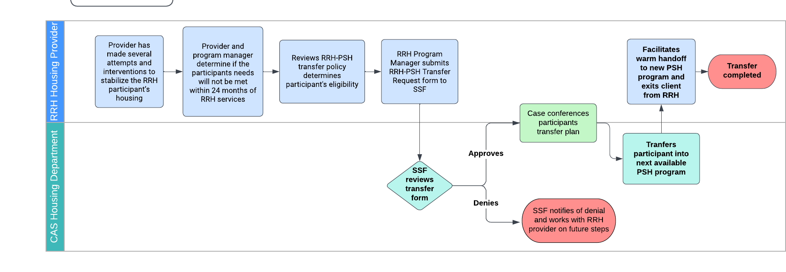
Transfer Process

Slide 9
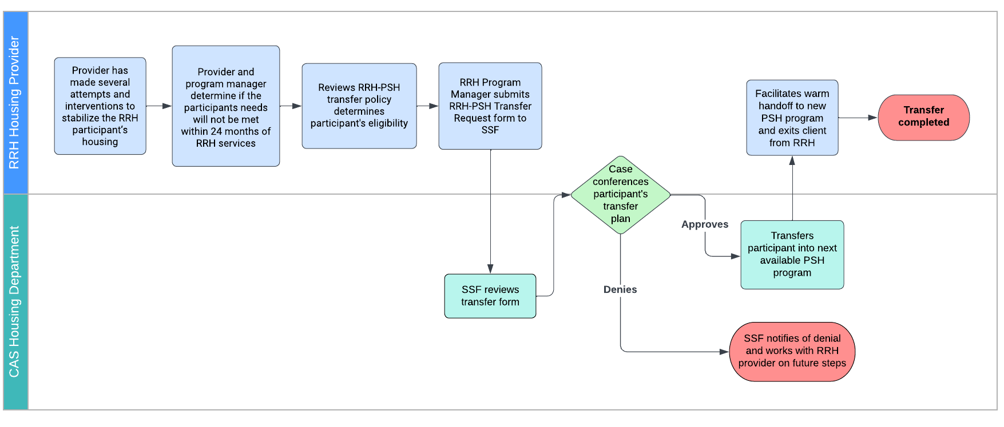
Transfer Process (scenario 2)

Slide 10
Questions or comments?
Thank you for your time!

